Slide 1
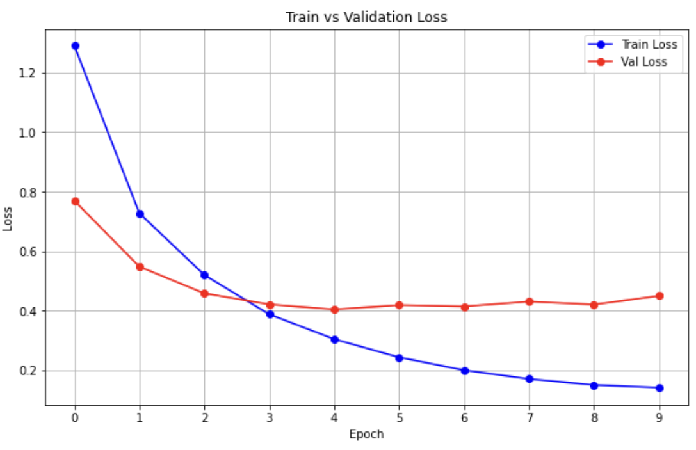
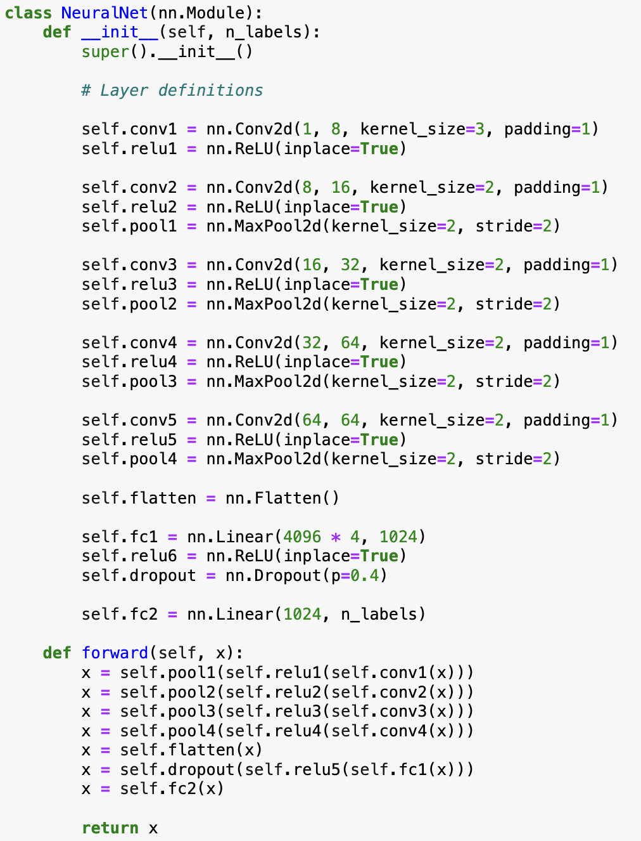
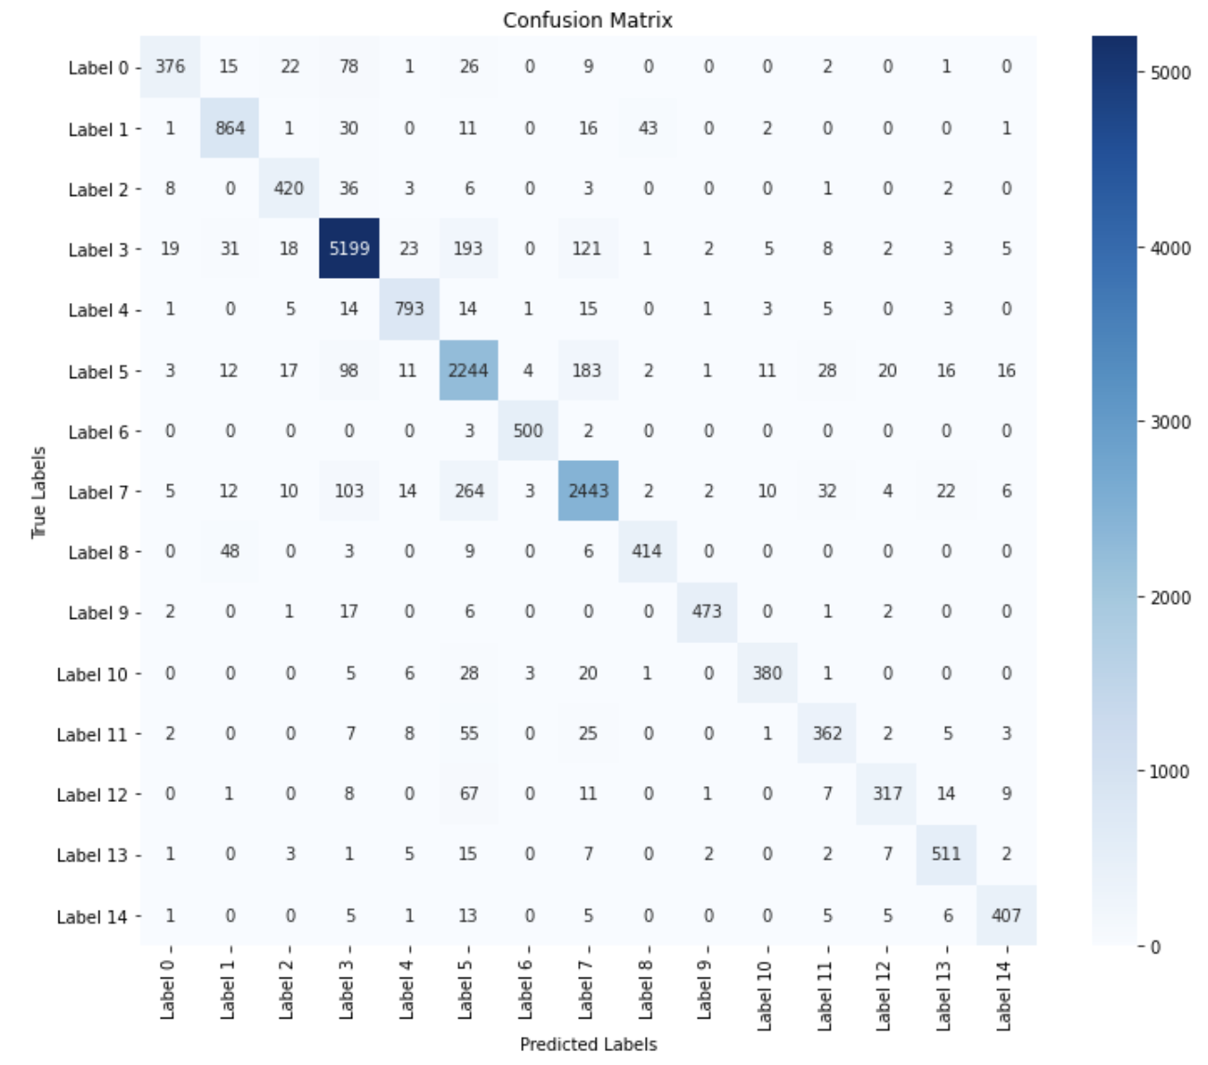
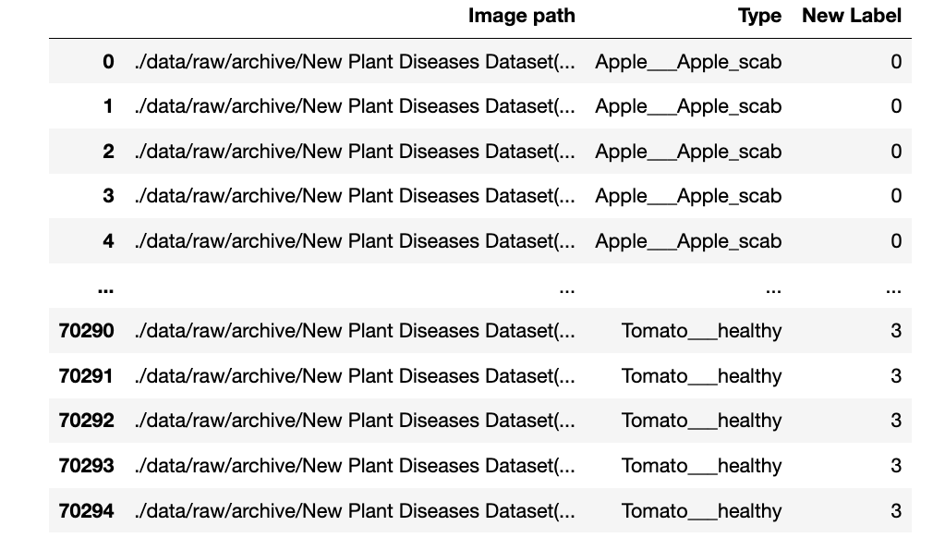
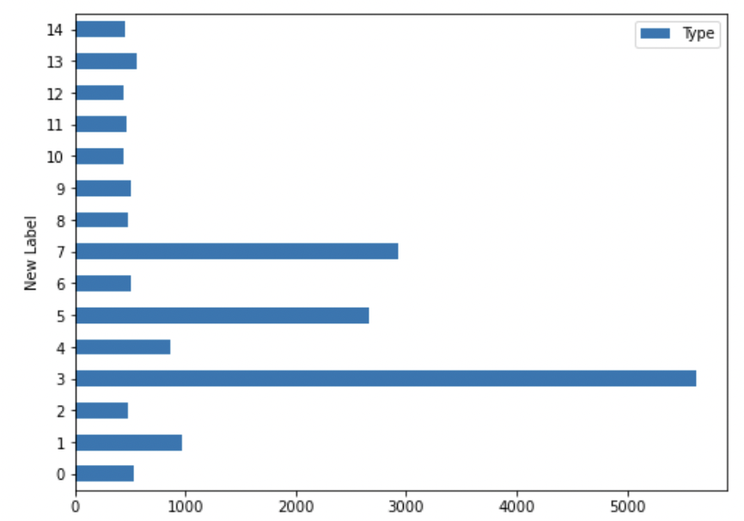
Plant Disease Detection
Ishaan Chadha, Chanyoung Park, Brandon Ng, Harry Wang
University of California San Diego DS3 Project Showcase
Introduction
Plant diseases pose a significant threat to global food security, affecting crop yields and leading to substantial economic losses. Early and accurate detection of plant diseases can greatly enhance mitigation strategies, preventing outbreaks and ensuring the sustainability of agricultural production.
We leverage advanced machine learning techniques to develop a Convolutional Neural Network (CNN) capable of identifying and classifying various plant diseases. Utilizing a comprehensive Kaggle "New Plant Diseases Dataset," our model aims to accurately diagnose plant diseases from images, providing a reliable tool for farmers and agricultural researchers.
By automating disease detection, our solution promises to improve response times and accuracy over traditional methods, potentially transforming plant health management systems and enhancing crop resilience against diseases.
Data Cleaning
1. Image Organization: Images were categorized into distinct folders based on their disease labels to streamline the loading and processing stages.
2. Quality Checks: We conducted manual inspections to remove corrupted or irrelevant images, ensuring the integrity of our training data.
3. Resizing and Normalization: All images were resized to a uniform dimension (256x256 pixels) to maintain consistency across the dataset. Pixel values were normalized to a range of 0 to 1 to facilitate faster convergence during training.
4. Label Encoding: Disease categories were encoded into numerical labels to simplify model processing.
Model Architecture
Our neural network is tailored for precise detection and classification of plant diseases, using the Adam optimizer for efficient learning. It comprises convolutional and pooling layers, followed by fully connected layers, enabling it to effectively extract and classify detailed plant features.
Convolutional Layers: Sequential layers starting with 8 filters and expanding to 64, paired with ReLU activation to introduce non-linearity and MaxPooling to reduce dimensionality.
Flattening: Converts 2D feature maps into a 1D vector to feed into the dense layers.
Dense Layers:
Fully Connected Layer: Incorporates 1024 neurons equipped with a 40% dropout rate to enhance generalization and prevent overfitting.
Output Layer: Directly outputs classification labels through integrated CrossEntropyLoss, which includes a Softmax function for precise probability distribution among classes.
CNN Analysis
Our Convolutional Neural Network exhibits effective learning dynamics, as evidenced by the rapid convergence of training and validation losses within the initial epochs. The use of early stopping—triggered after 5 epochs without improvement—prevents overfitting and optimizes computational resources. Both losses stabilize by the 9th epoch, indicating a well-tuned model that generalizes well to unseen data.
Results
Our Convolutional Neural Network achieved an impressive overall accuracy of 88%, demonstrating strong predictive capabilities and high precision and recall across various plant diseases.
Confusion Matrix Analysis:
Diagonal Dominance: The matrix displays significant diagonal dominance, indicating accurate predictions across most disease labels, with particularly strong performance in classes with a high number of samples.
Misclassification Insights: There are noticeable confusions between certain labels (e.g., Label 0 and Label 1, Label 4 and Label 5), which could be attributed to similar morphological features in the diseases they represent. These insights can direct specific improvements in model training.
Implications: Future improvements will focus on refining misclassifications by utilizing advanced preprocessing techniques, expanding training data for underrepresented classes, and exploring more complex neural network architectures.
Future Directions:
Diverse Data Integration: Enhance the model's real-world applicability by incorporating datasets from varied geographic and environmental conditions.
Automated Retraining: Implement a continuous learning system to automatically update the model with new data, improving its responsiveness to emerging plant diseases and environmental shifts.
Challenges
Data Imbalance: Handling imbalanced datasets where some diseases were significantly overrepresented compared to others, potentially skewing the model's ability to generalize across less common plant diseases.
Limited Data for Rare Diseases: The scarcity of examples for certain plant diseases limited the training data available, making it difficult to train the model to recognize these less common conditions accurately.
Model Complexity and Computation Constraints: Balancing model complexity with computational efficiency was challenging, especially when trying to improve accuracy without significantly increasing the training time and resource consumption.
.

